Slide 1
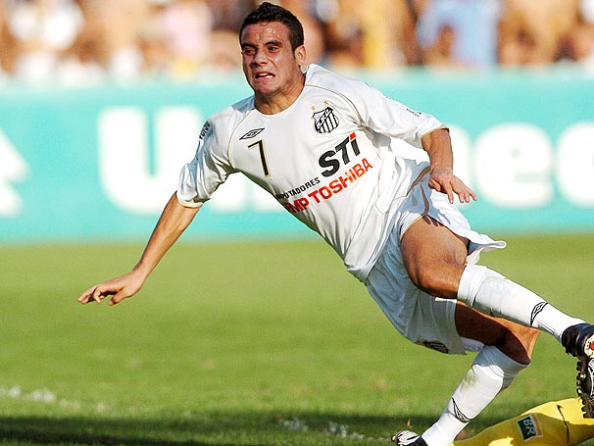
The Knee Anatomy and Injuries

Slide 2
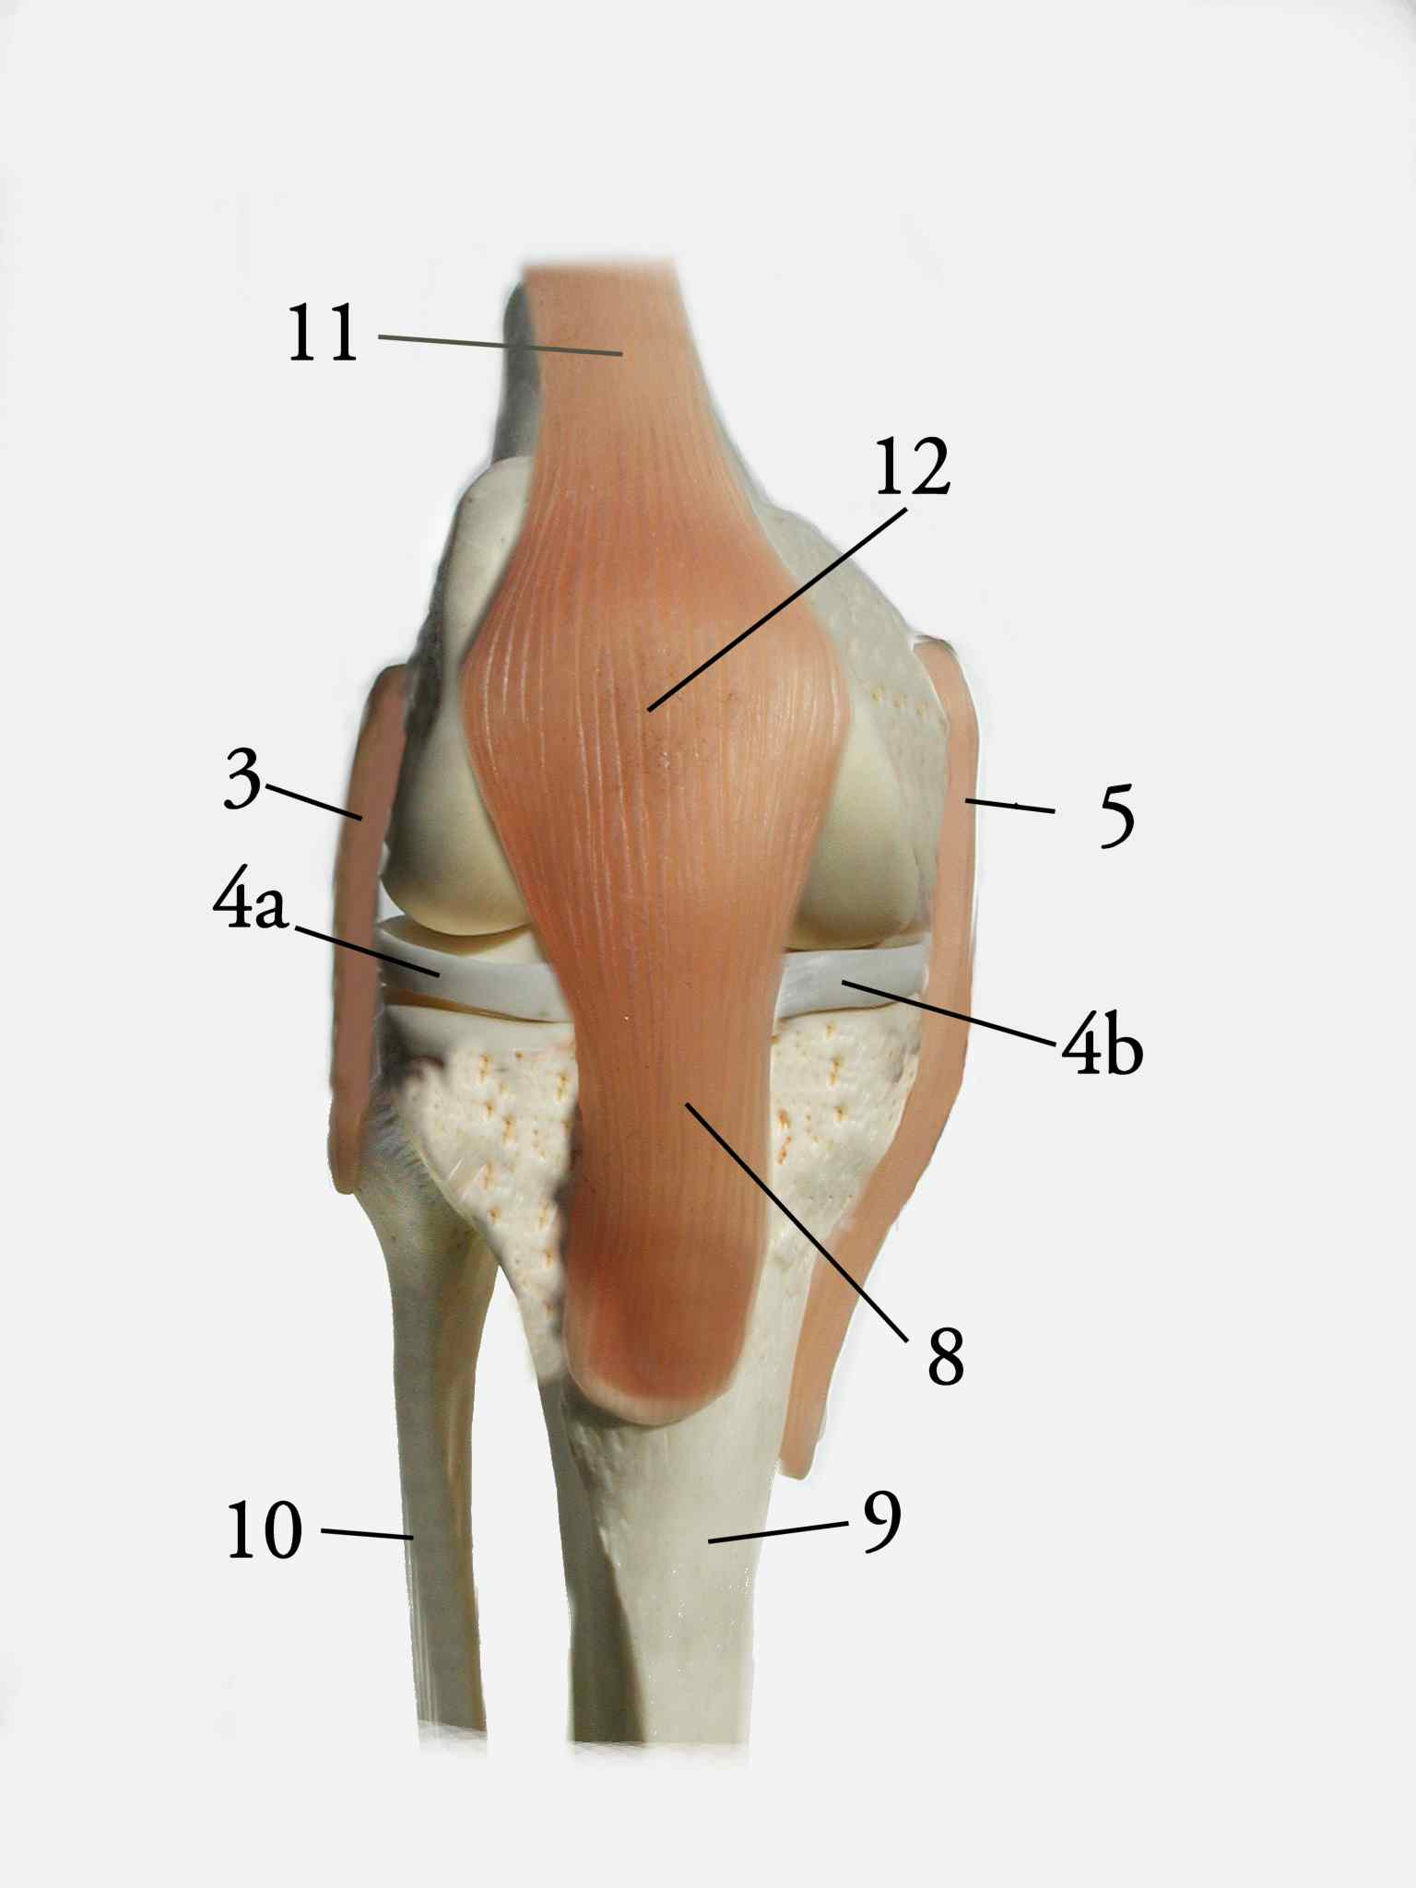
Knee Anatomy
Introduction
On the diagram, identify and label the structures of the knee.

Slide 3
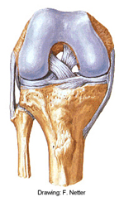
Knee Anatomy
On the diagram, identify and label the structures of the knee.

Slide 4
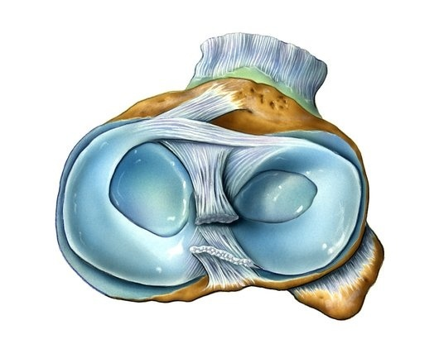
Knee Anatomy
On the diagram, identify and label the structures of the knee.

Slide 5
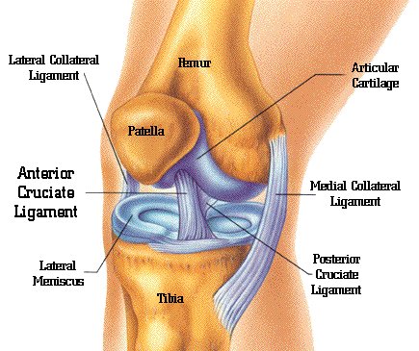
Knee Anatomy

Slide 6
Knee anatomy
Femur
Strongest bone in your body! It bears your weight on rounded CONDYLES that articulate with the tibia. It requires a lot of force to break the femur.
Patella
A sesamoid bone that sits INSIDE the quadriceps tendon. Its job is to provide extra leverage for the strong quads to contract & move the knee without damaging the tendon due to friction.
Meniscus
*The meniscus has poor blood supply to the inner 2/3s of the cartilage!
Lateral Meniscus
An O-shaped piece of cartilage that sits on the lateral side of the tibial plateau. It cushions the knee joint during flexion & extension but is prone to injury due to compression & rotation, a lot of times happening at the same time as an MCL injury.
Medial Meniscus
A C-shaped & slightly thicker cartilage that pads the medial portion of the tibial plateau. Commonly injured during LCL sprains due to compression, or ACL injuries due to the rotation

Slide 7
Knee Anatomy
Ligaments
Medial Collateral Ligament
Provides rotary (twisty ☺) stability to the medial side of the joint, connected to the tibia & femur. This ligament is very strong & thick, but is still more commonly injured than the LCL due to the mechanism.
Lateral Collateral Ligament
A cord-like ligament connecting the fibula, tibia, & femur on the lateral side of the joint, also providing rotary stability to the knee. It can be palpated by putting one ankle on the opposite knee while sitting, then finding the joint space between the tibia & fibula on the bent knee.
Anterior Cruciate Ligament
Cruciate literally translates to “cross-shaped” in Latin. The ACL begins at the posterior base of the femur & attaches at the anterior top of the tibia. It’s fibers control any anterior or forward movement of the knee during movements such as squatting, running, walking up or down stairs, & just walking on a flat surface.
Posterior Cruciate Ligament
CROSSING from the anterior base of the femur, behind the ACL & attaching onto the posterior top of the tibia, the PCL is in charge on preventing any backward slippage of the tibia during knee movement.

Slide 8
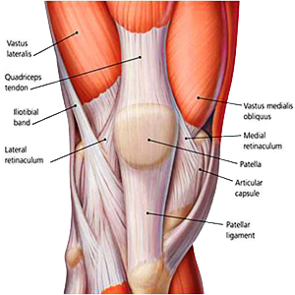
Knee Muscle Anatomy
Anterior Muscles of the Knee

Slide 9
Rectus Femoris Muscle
Most anterior & superficial quad muscle
Main extender of the knee
Turns into the quadriceps tendon & holds what bone?!
Think of some injuries that may involve this muscle…

Slide 10
Quadriceps
Rectus Femoris
Origin
Anterior inferior iliac spine (AIIS)
Insertion
Tibial tuberosity
Action
Extension of the knee
Hip flexion

Slide 11
Vastus Medialis Muscle
Most medial quad muscle
In charge of internal rotation of the tibia & assists with extension of the knee
Also stabilizes the patella medially
What are some affects that a weak VMO may have?

Slide 12
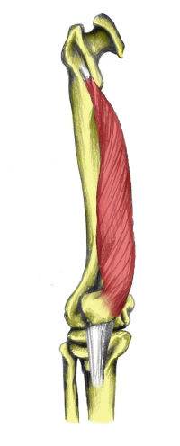
Quadriceps
Vastus Medialis
Origin
Femur
Insertion
Tibial tuberosity
Action
Extension of the knee

Slide 13
Vastus Lateralis Muscle
Most lateral quad muscle
Assists with extension of the knee & lateral stabilization of the patella
What might over tightness or weakness of this muscle cause?

Slide 14
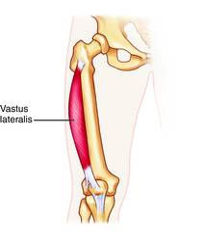
Quadriceps
Vastus Lateralis
Origin
Femur
Insertion
Tibial tuberosity
Action
Extension of the knee

Slide 15
Vastus Intermedius Muscle
Most inferior quad muscle – sits beneath the rectus femoris
Helps extend the knee
Makes up the inferior fibers of the quadriceps tendon

Slide 16
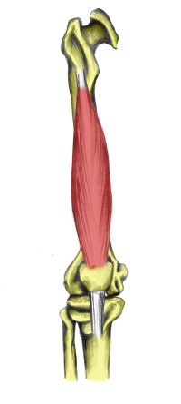
Quadriceps
Vastus Intermedius
Origin
Anterior femur
Insertion
Tibial tuberosity
Action
Extension of the knee

Slide 17
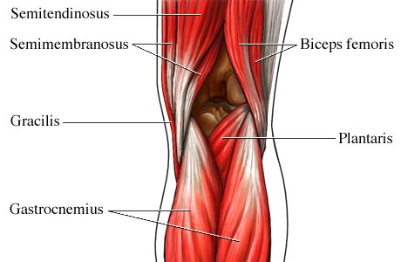
Knee Muscle Anatomy
Posterior Muscles of the Knee

Slide 18
Biceps Femoris Muscle
Largest muscle in the hamstring group
Gives the hamstring its characteristic bulge
Divided into how many muscle bellies?
How many daily activities can you think of that involve your hamstrings?

Slide 19
Hamstrings
Biceps Femoris
Origin
Long head-ischial tuberosity
Short head-posterior femur
Insertion
Head of fibula
Action
Extension of hip
Flexion of the knee

Slide 20
Semimembranosus Muscle
Most medial hamstring muscle
Flexes the knee, extends the hip with a straight leg, rotates the tibia medially with a straight leg
Palpate the semimembranosus muscle on a partner

Slide 21
Hamstrings
Semimembranosus
Origin
Ischial tuberosity
Insertion
Posterior medial tibia
Action
Extension of hip
Flexion of the knee

Slide 22
Semitendinosus Muscle
Sits right beneath the semimembranosus
Medial & inferior
Guess what motions this muscle helps with!

Slide 23
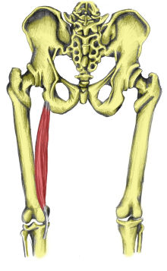
Hamstrings
Semitendinosus
Origin
Ischial tuberosity
Insertion
Anterior tibia
Action
Extension of hip
Flexion of the knee

Slide 24
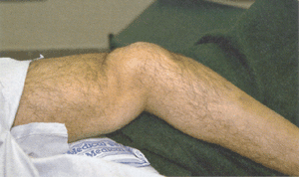
Knee Injuries

Slide 25
Knee Valgus Injuries

Slide 26
Knee Valgus Injuries - MCL

Slide 27
Knee Varus Injuries

Slide 28
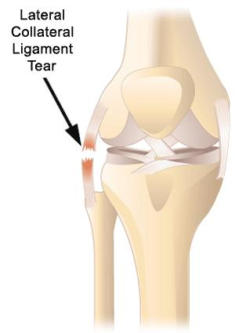
Knee Varus Injuries - LCL

Slide 29
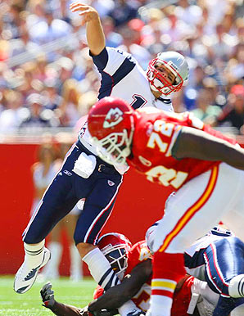
Knee Rotary Injuries

Slide 30
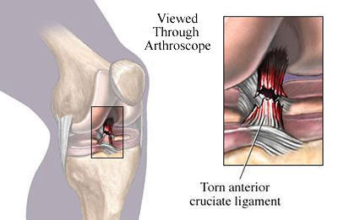
Knee Rotary Injuries ACL

Slide 31
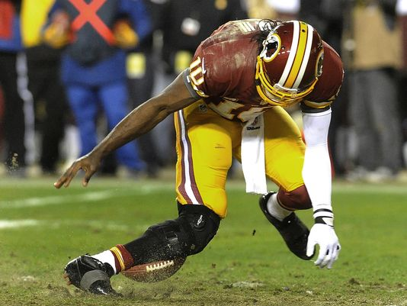
Knee Rotary Injuries

Slide 32
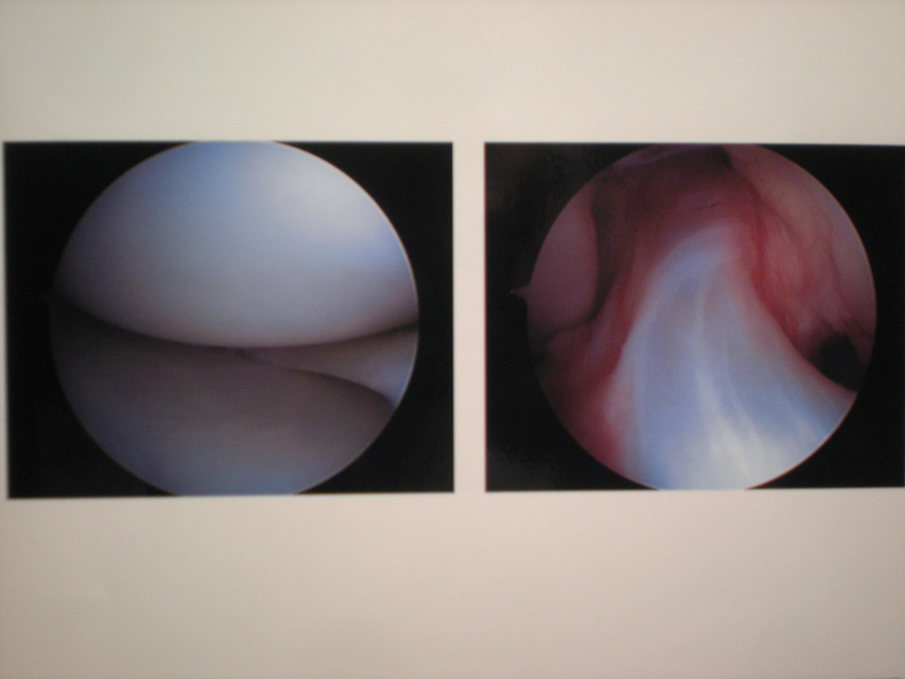
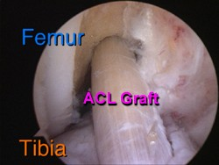
The Knee ACL

Slide 33
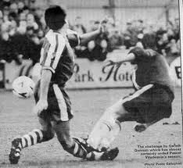
The Knee Hyperextension Injuries

Slide 34
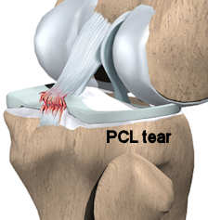
The Knee Hyperextension Injuries

Slide 35
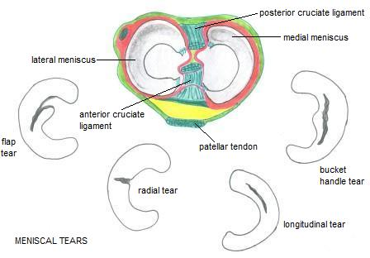
The Knee Meniscus Injuries

Slide 36
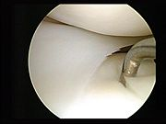
The Knee Meniscus Injuries

Slide 37
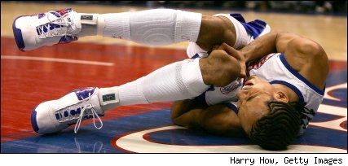
The Knee Patella-Femoral Injuries

Slide 38
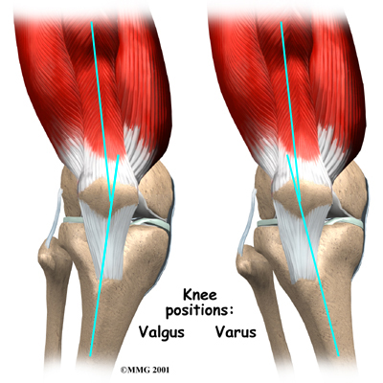
The Knee Patella-Femoral Tracking Injuries

Slide 39
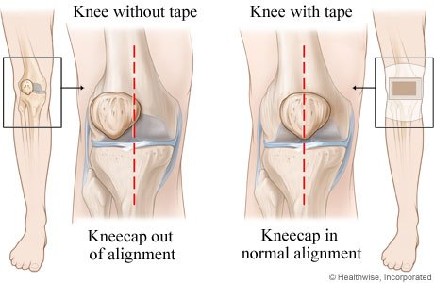
Knee Patella-Femoral Tracking Injuries

Slide 40
SOAP Note Write-Up
With a partner, place the following information in the correct section of a SOAP Note:
A 15 year old female soccer player was running after a ball during a game when she took a step to turn, heard & felt a pop in her left knee, then fell to the ground. She had pain that was a 7/10 at the time but after a few minutes it calmed down. She limped off the field to the evaluation table, barely willing to put weight on her left leg. She still felt a painful pop in the knee with every step. There is already some mild swelling at the lateral aspect of her knee joint. No ecchymosis or deformity. She’s never had a knee injury before, just a few jammed fingers but she “has a high pain tolerance.” Extremely tender to palpation at the lateral joint line; relatively painless everywhere else. Very limited AROM with left knee flexion; 8/10 pain while extending; Unable to perform PROM/MMT. (+) Valgus stress due to compression of lateral knee; (+) Apley’s Compression for severe, diffuse pain in the left knee; (+) Apley’s distraction for relief of pain; (+) McMurray’s for lateral joint line pain, worst during valgus stress & passive knee flexion; (+) Thessaly due to inability to balance in a slight squat on the left leg; (-) Anterior/posterior drawer; (-) Lachman’s; (-) Godfrey 90-90

